Slide 1


INVESTIGATING EARTHQUAKE DETERMINISM WITH A MULTI-METHOD APPROACH
Transfer of Status
Rebecca L. Colquhoun (she/they)
Supervisors: Jess Hawthorne and Tom Garth (ISC)
@RebeccaC13 -- rebecca.colquhoun@univ.ox.ac.uk

Slide 2
THE QUESTION
Can we distinguish an earthquake’s magnitude before rupture is complete?
Question

Slide 3
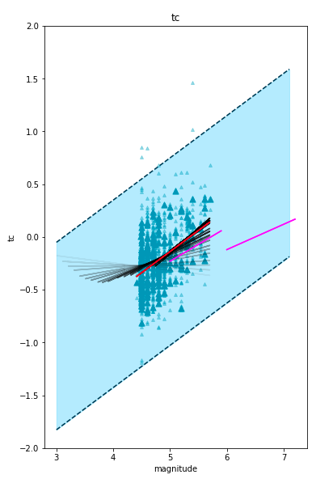

Slide 4
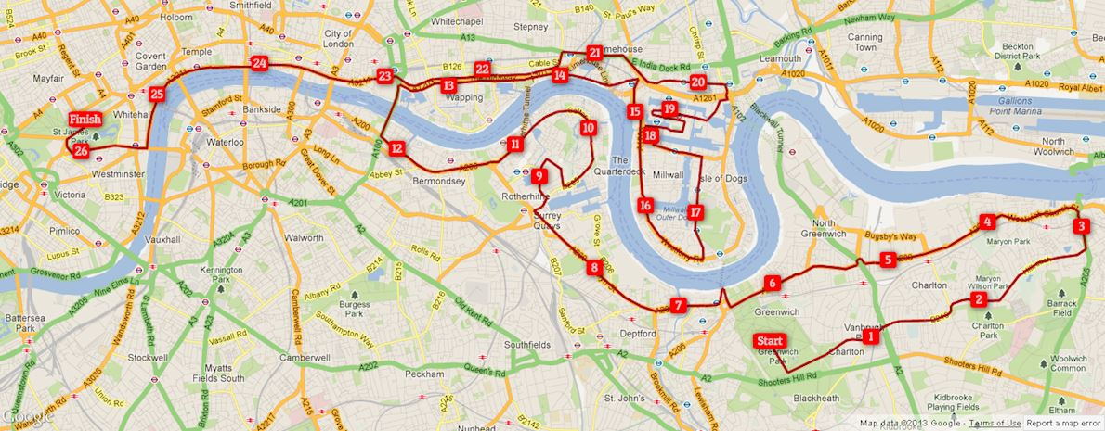
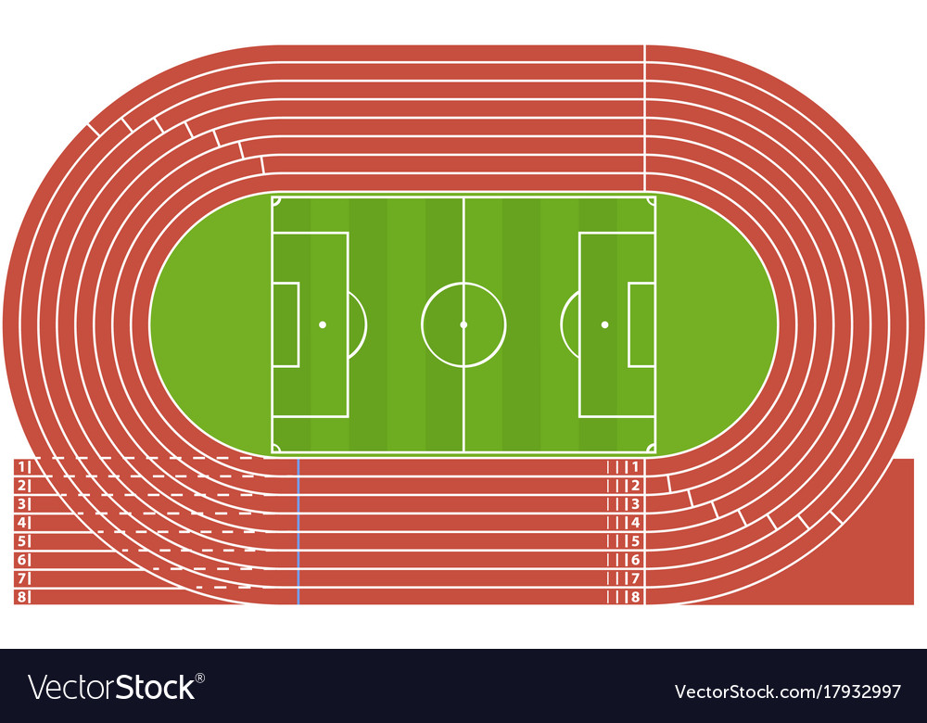



HOW FAR CAN THE EARTHQUAKE GO?
1
Initial (fault) conditions
Question

Slide 5
HOW FAR CAN THE EARTHQUAKE GO?
Measurement at 10 minutes:
Rebecca : 5 miles
Sir Mo: 26 miles
1
Question

Slide 6
HOW FAR CAN THE EARTHQUAKE GO?
1
Question

Slide 7
HOW FAR CAN THE EARTHQUAKE GO?
Measurement at 10 minutes:
Rebecca : 10 miles
Sir Mo: 10 miles
1
Question

Slide 8

WHY DOES IT MATTER?
People
Crack-like
1
2
3
4
Mechanical questions
slip
1
2
3
4
time
Pulse-like
4
3
2
1
2
3
4
slip
1
2
3
4
Question
Notes:
Pulse vs crack
Weak det - organises into a self similar slip pulse with kinematic prop that scales with mag
During crack‐like rupture, slip grows as the crack expands after nucleation. Slip continues everywhere on the fault until rupture at the edges of the rupture front stops; then slip arrests along the entire fault once information is received that the rupture has terminated. In this model, the local duration of slip (the rise time, τ_{r}) is comparable to the total duration of rupture (the source duration T_{d}). In the self‐healing pulse model (Heaton, 1990), slip occurs only over a narrow annular zone propagating outward from the hypocenter, between the rupture front and a healing front that follows at some distance behind (the pulse width).

Slide 9
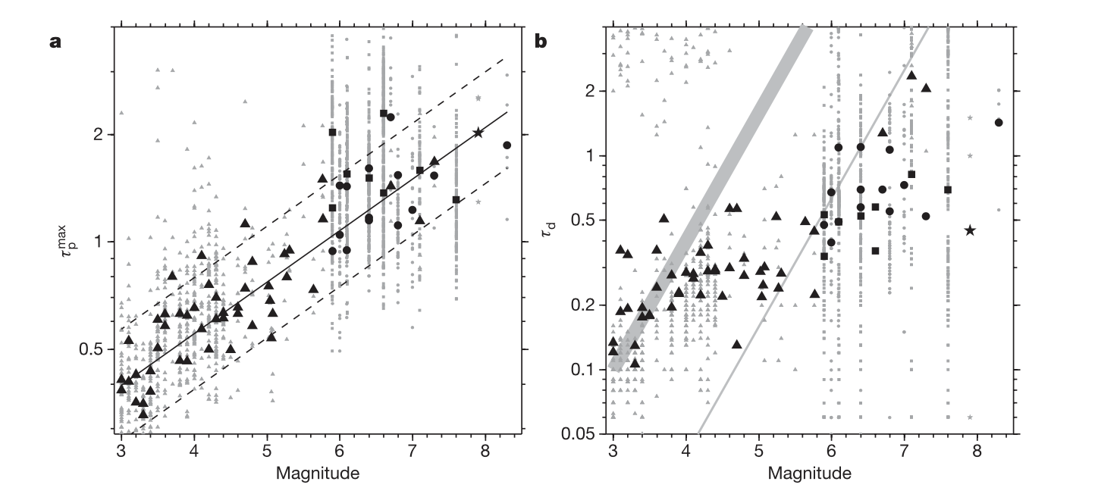
WHAT HAS BEEN DONE BEFORE?
Measurements of predominant period looking at first 4 seconds (71 eq, M3+) → DETERMINISTIC
±M1 error (Olsen and Allen, 2005)
Rupture duration
10% of rupture duration
Time required to measure maximum predominant period
Maximum predominant period
Olson and Allen (2005)
Olson and Allen (2005)
Magnitude
Magnitude
Past work
Notes:
In the past, 2 main approaches have been taken to investigate earthquake determinism. The first is looking at the predominant period of the signal. Here I am showing some results from this Olsen and allen paper. They looked at the predominant period through time using a recursive relation, and then defined a maximum predominant period as the maximum of this in the first 4 seconds. So you can see on the left figure that the maximum predominant period increases with magnitude in a clear fashion, but with a significant error of around 1 magnitude unit. This led to criticism because you if you repeat the method on a dataset with a smaller magnitude range, then there is no observable trend. They also showed in the right hand figure that the time that the maximum occurred at is much less than the rupture duration shown by the thick grey line at higher magntiudes. This all tells us that earthquakes are deterministic.

Slide 10
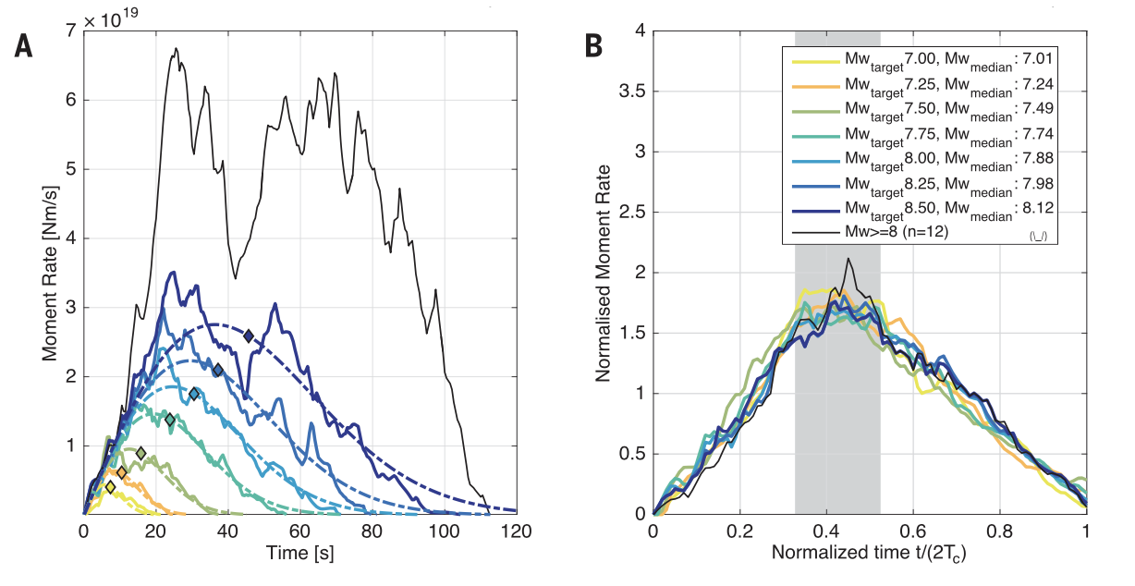
WHAT HAS BEEN DONE BEFORE?
Source-time functions → NON-DETERMINISTIC
Look at a narrow magnitude window + limited settings
Only used down to approx. M6 (Meier et al. 2017)
Moment rate (Nm/s)
Normalised moment rate
(so area = 1)
Meier et al. 2017
Time (s)
Normalised time
Time/(2 x centroid duration)
Past work
Notes:
Not so fast though – other people, like this paper by meier et al took a look at source time functions. Source time functions are only generally used down to magnitude 6, but this paper only used magnitude 7+ subduction zone earthquakes. They took seven target moment magnitudes, and then chose the STFs from the 20 events with most similar magnitudes and then found the median STF amplitude in each bin at each point in time. These are plotted in the left hand panel which shows that the medians behave fairly regularly, with near-triangular and almost symmetrical shapes. The STFs grow linearly at the same average growth rate for all magntiudes until the peak moment rate is reached and then start decaying with a similar rate.
They then normalised each individual STF by dividing the time by 2 times the centroid duration and again took the median. From this you can see that all the magntiudes have very similar normalised source time functions suggesting earthquakes are not deterministic.

Slide 11
MY PHD: A SUMMARY
Consistency of results
Reflect same physics?
Spectral Analysis
Setting dependence?
e.g. depth, fault type
Need local scalings?
Source-time functions
Dataset
SELECTION OF METHODS
IDEAL RESULTS
Reduce/better understand uncertainty
Foreshocks
Real world applications

Slide 12
MY PHD: A SUMMARY
Consistency of results
Reflect same physics?
Spectral Analysis
Setting dependence?
e.g. depth, fault type
Need local scalings?
Source-time functions
Dataset
SELECTION OF METHODS
IDEAL RESULTS
Reduce/better understand uncertainty
Foreshocks
Real world applications

Slide 13
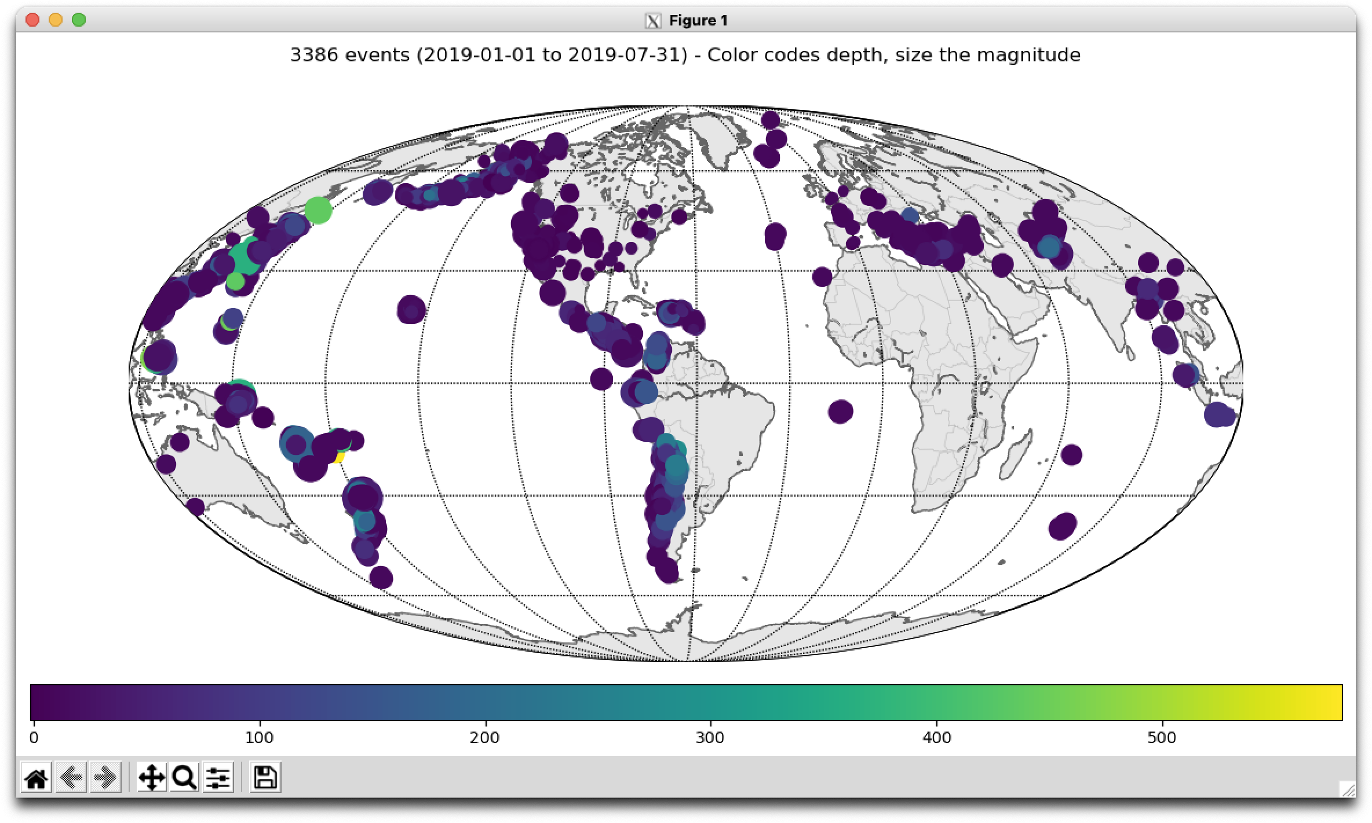
DATASET
3386 M3+ earthquakes
Instrument within 200 km
January—July 2019
Globally distributed
0
Depth (km)
100
200
300
400
500
Method

Slide 14
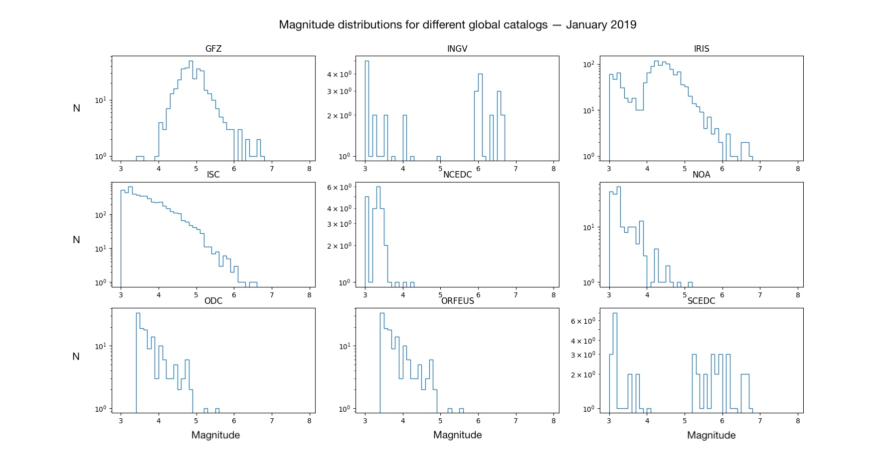
DATASET
ISC
IRIS
100
100
N
N
10
10
1
1
3
4
5
6
7
8
3
4
5
6
7
8
magnitude
magnitude
The “definitive record of the Earth's seismicity”.
Cannot use to access waveform data.
US-based.
Facility for the “acquisition, management, and distribution of seismological data”
Method

Slide 15
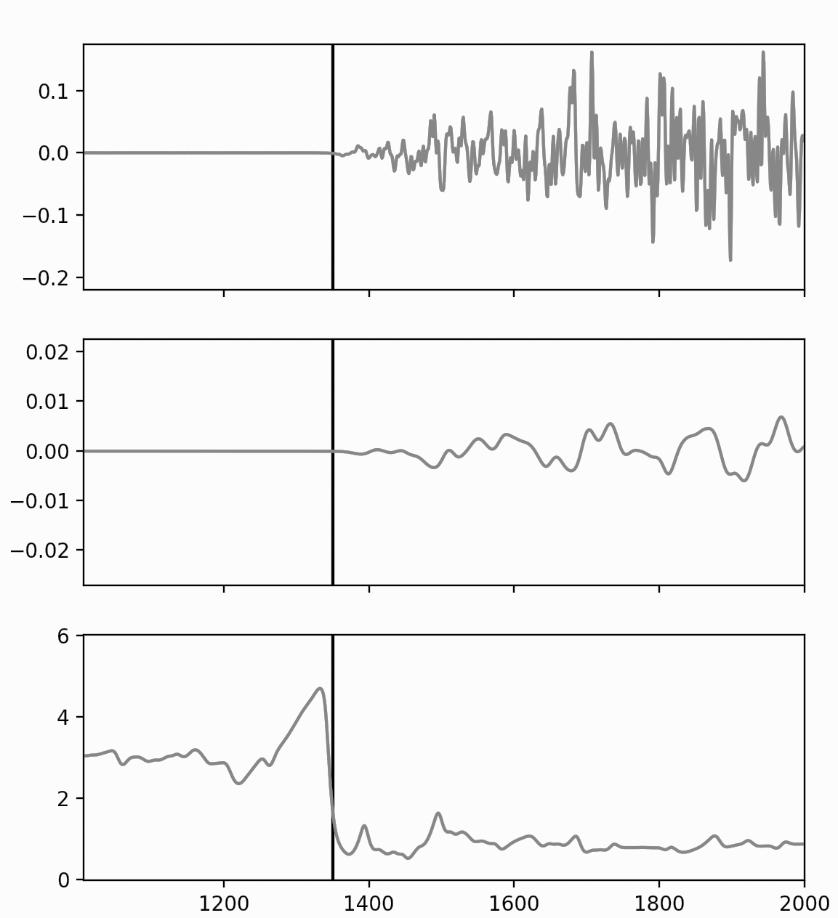
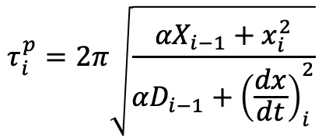

CALCULATING PREDOMINANT PERIOD
Mw 8.3 Tokachi-oki earthquake
Similar to a rolling average in approach
Take maximum value in 4 second after pick
Need accurate picks
→ use EQTransformer ML algorithm
Filtering is key
Measured velocity (low pass filtered)
acceleration
Predominant period at time i
$$τ_{i}^{p}=2π\sqrt{\frac{{αX}_{i−1}+x_{i}^{2}}{{αD}_{i−1}+{\left(\frac{dx}{dt}\right)}_{i}^{2}}}$$
velocity
Smoothing parameter
Olson and Allen (2005)
predominant period
$$τ_{max}^{p}$$
Samples since record began
Method
Notes:
Dx/dt = acceleration

Slide 16
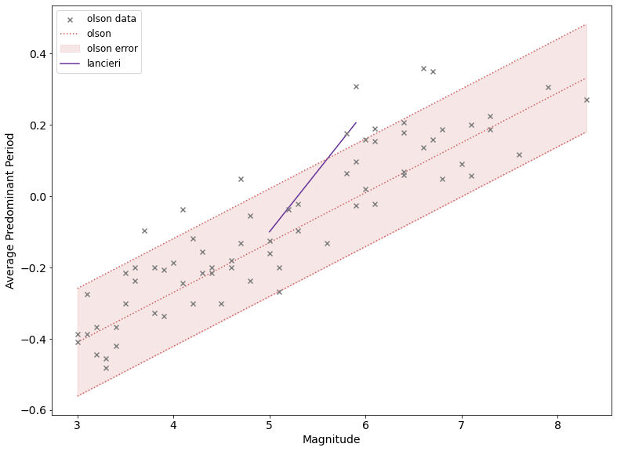
PREDOMINANT PERIOD
Measurements of predominant period looking at first 4 seconds (71 eq, M3+)
±M1 error (Olsen and Allen, 2005)
Maximum predominant period
Magnitude
Methodology
Method
Past work
Notes:
In the past, 2 main approaches have been taken to investigate earthquake determinism. The first is looking at the predominant period of the signal. Here I am showing some results from this Olsen and allen paper. They looked at the predominant period through time using a recursive relation, and then defined a maximum predominant period as the maximum of this in the first 4 seconds. So you can see on the left figure that the maximum predominant period increases with magnitude in a clear fashion, but with a significant error of around 1 magnitude unit. This led to criticism because you if you repeat the method on a dataset with a smaller magnitude range, then there is no observable trend. They also showed in the right hand figure that the time that the maximum occurred at is much less than the rupture duration shown by the thick grey line at higher magntiudes. This all tells us that earthquakes are deterministic.

Slide 17
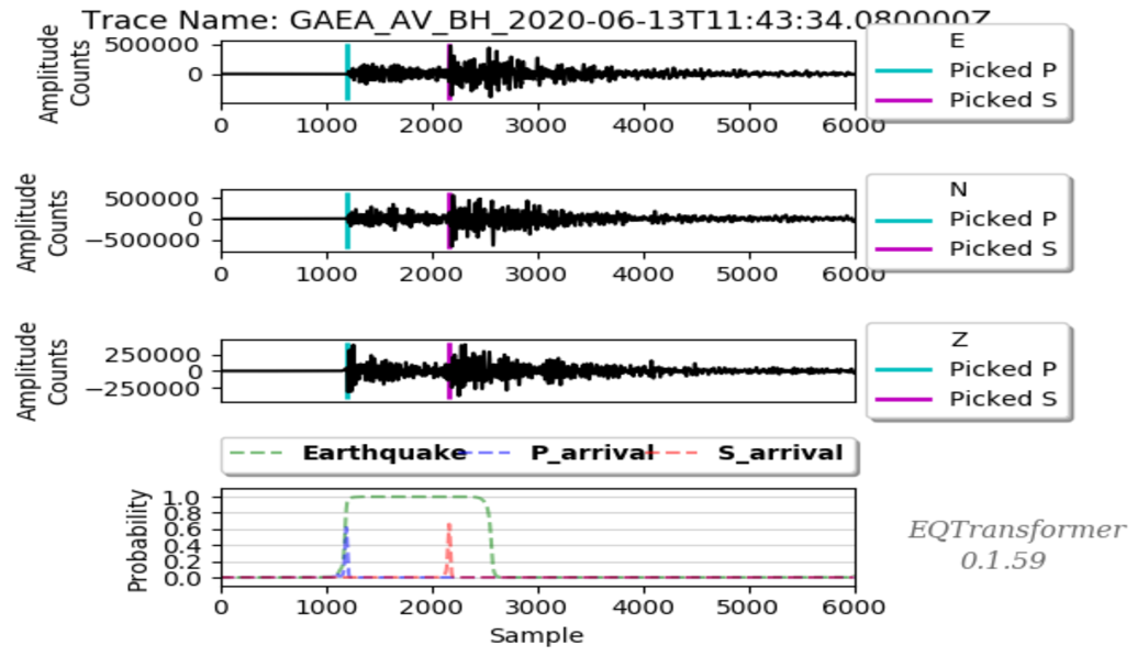
GETTING ACCURATE PICKS
Use EQTransformer (Mousavi et al., 2020)
Advantages:
Global training dataset
High precision + recall
Best at epicentral distances < 120 km
Doesn’t manage RAM well, so use reimplementation from SeisBench (Münchmeyer et al 2021; Woollam et al 2021)
Method

Slide 18
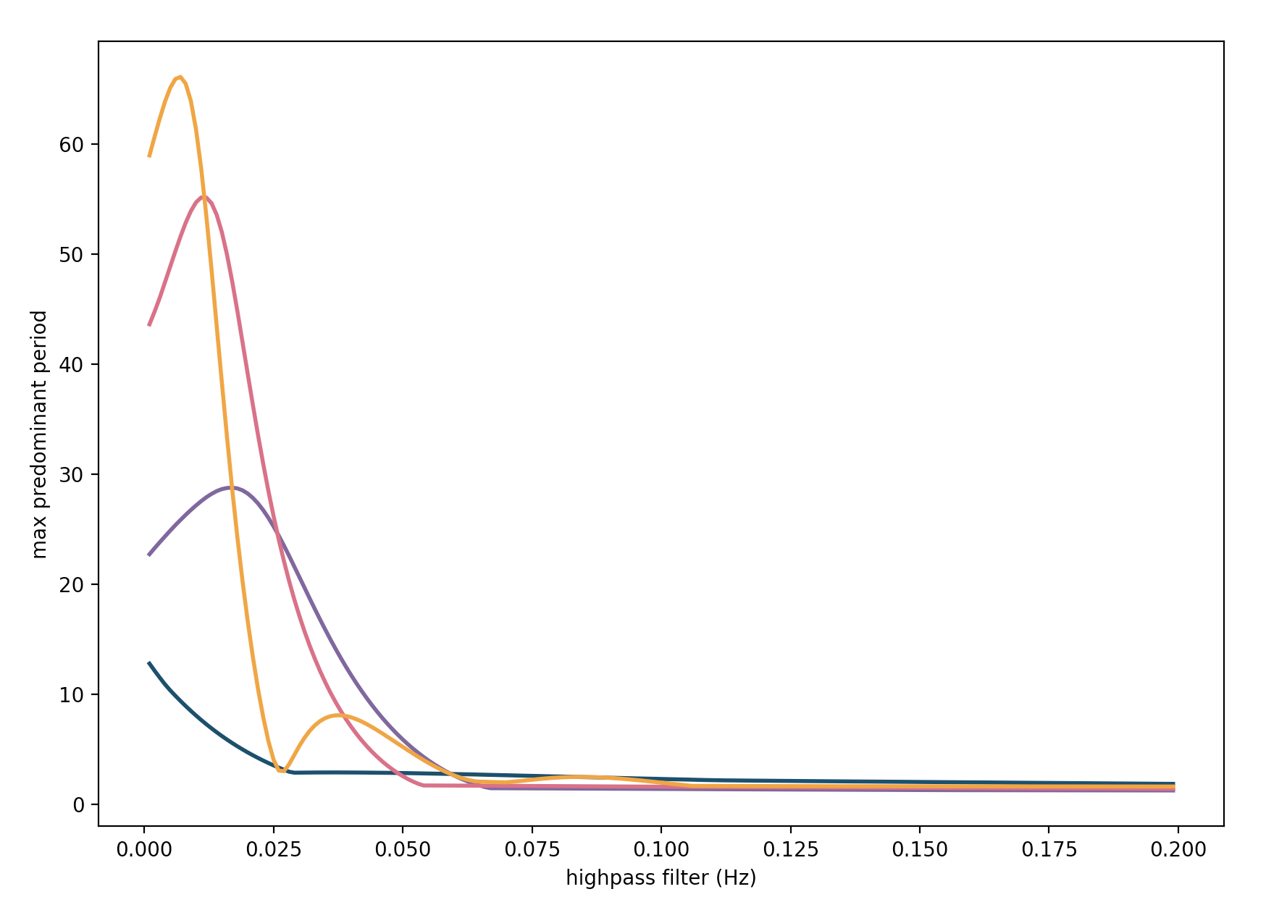
IMPORTANCE OF FILTERING
Need to remove long-period noise but keep signal
Predominant period plateaus rapidly when noise is removed
High-pass Butterworth filter
Noise biases predominant period to very high values
Mw 8.3 Tokachi-oki earthquake
Gain (dB)
0
Lower frequencies removed
1st order (1 corner)
Maximum predominant period
4 stations recorded the event within 100 km
Predominant period plateaued
3rd
Ideal response
6th
Increasing filter order
Frequency (Hz)
Cut-off frequency
Cut-off frequency for highpass filter (Hz)
Method
Notes:
Filtering is key to getting reliable results, particularly when we only have strong motion records.
There is a lot of long period noise which we need to remove whilst keeping the signal.
Predominant period plateaus rapidly once noise is removed.
When filtering data we can vary the cut-off frequency and the order or number of corners.
Corner number affects how abruptly the pass band ends.

Slide 19
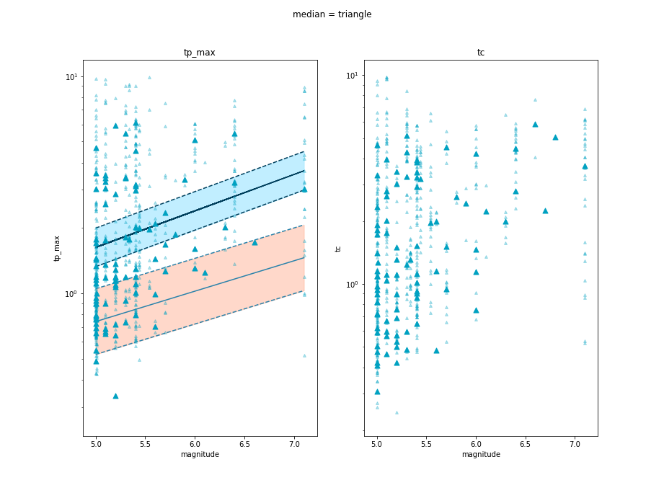

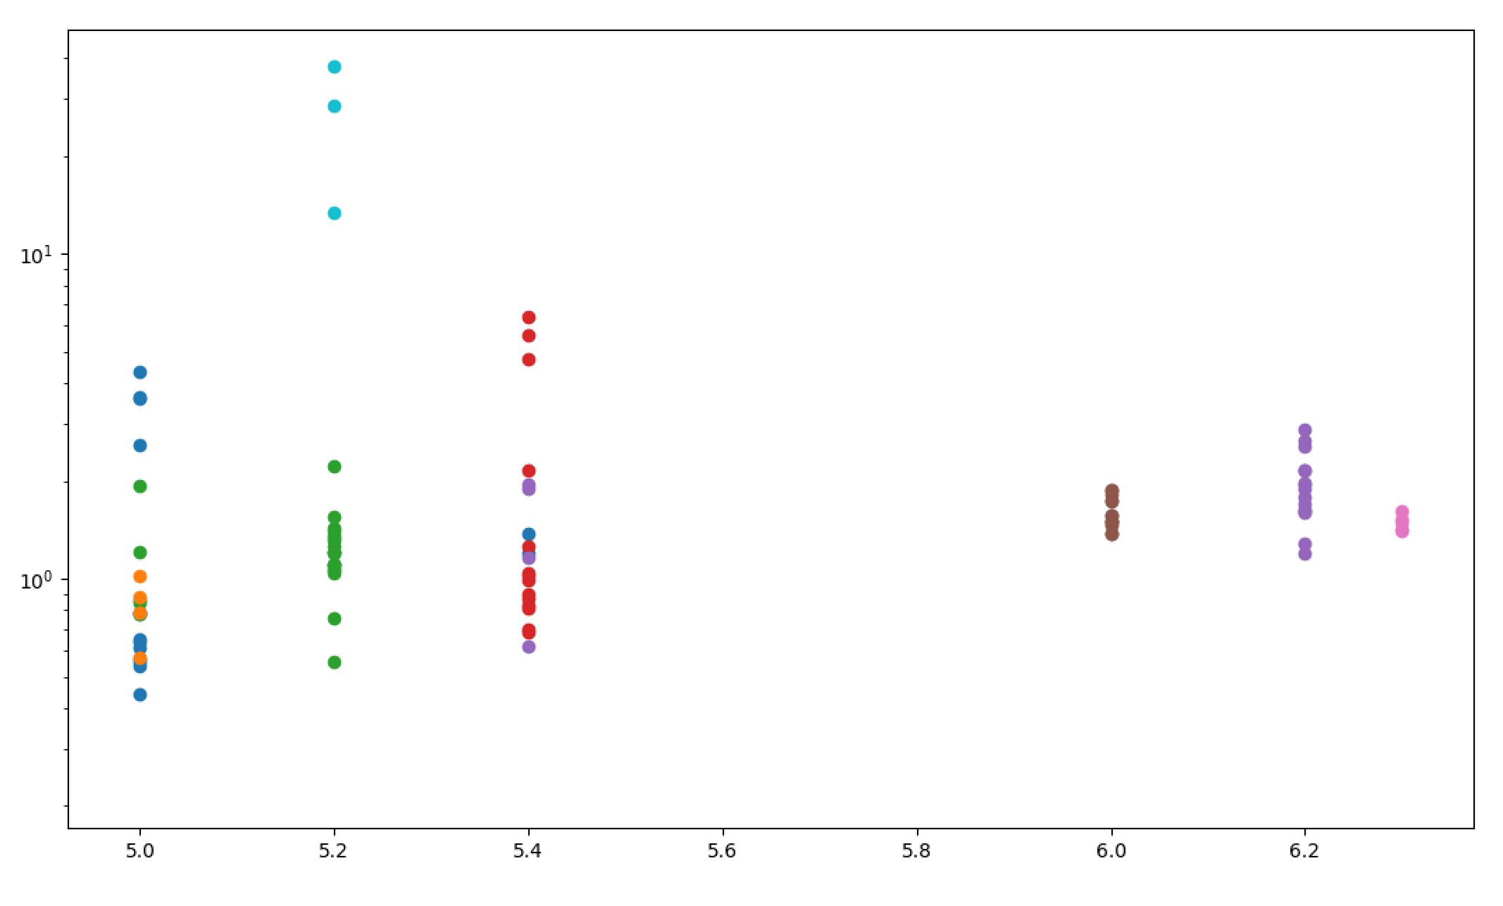
RESULTS
2
Maximum predominant period
1
0.5
3
4
5
6
7
Method
Magnitude
Past work
Question
Meaning

Slide 20
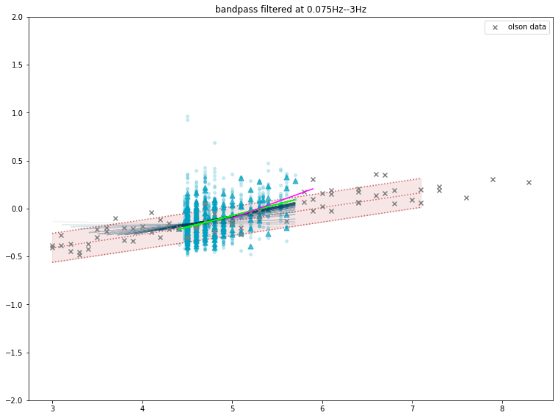
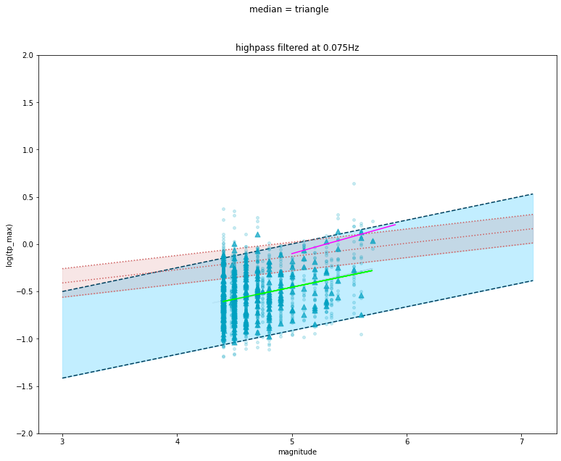
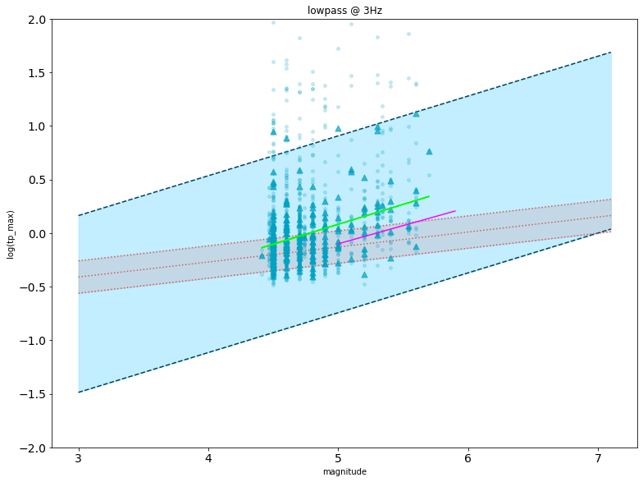
RESULTS
Gain (dB)
0
Ideal response
Frequency (Hz)
3 Hz
Log(Maximum predominant period)
Method
Past work
magnitude
Question
Meaning

Slide 21
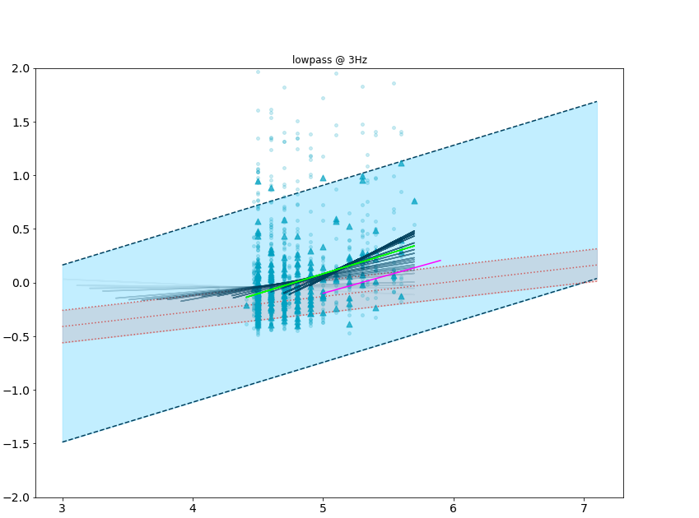
RESULTS
Gain (dB)
0
Ideal response
Frequency (Hz)
3 Hz
Log(Maximum predominant period)
Method
Past work
magnitude
Question
Meaning

Slide 22
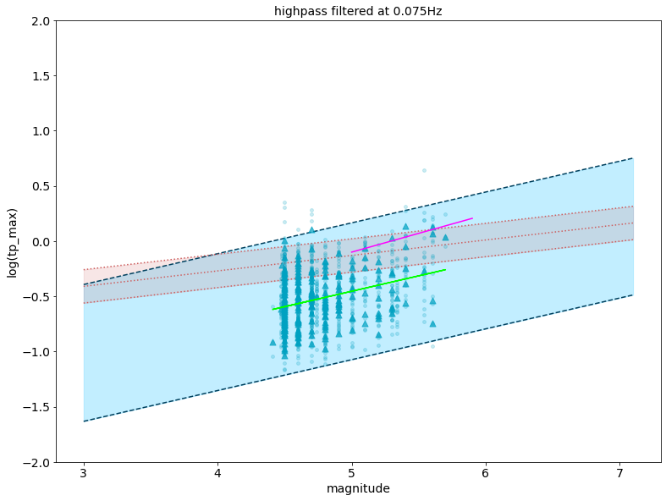
RESULTS
Gain (dB)
0
Ideal response
0.1 Hz
Frequency (Hz)
Log(Maximum predominant period)
Method
magnitude
Past work
Question
Meaning

Slide 23
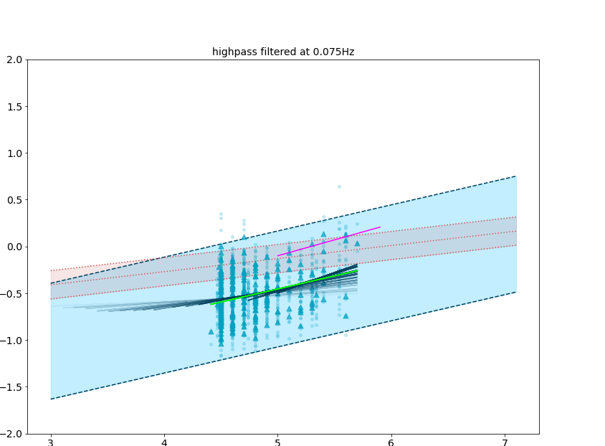
RESULTS
Gain (dB)
0
Ideal response
0.1 Hz
Frequency (Hz)
Log(Maximum predominant period)
Log(Maximum predominant period)
Method
Past work
magnitude
Question
Meaning
magnitude

Slide 24
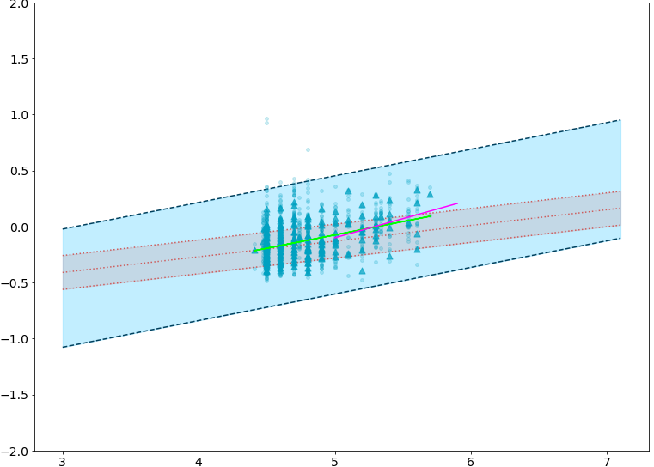
RESULTS
Gain (dB)
0
Ideal response
Frequency (Hz)
0.1 Hz
3 Hz
Log(Maximum predominant period)
Method
Past work
magnitude
Question
Meaning

Slide 25
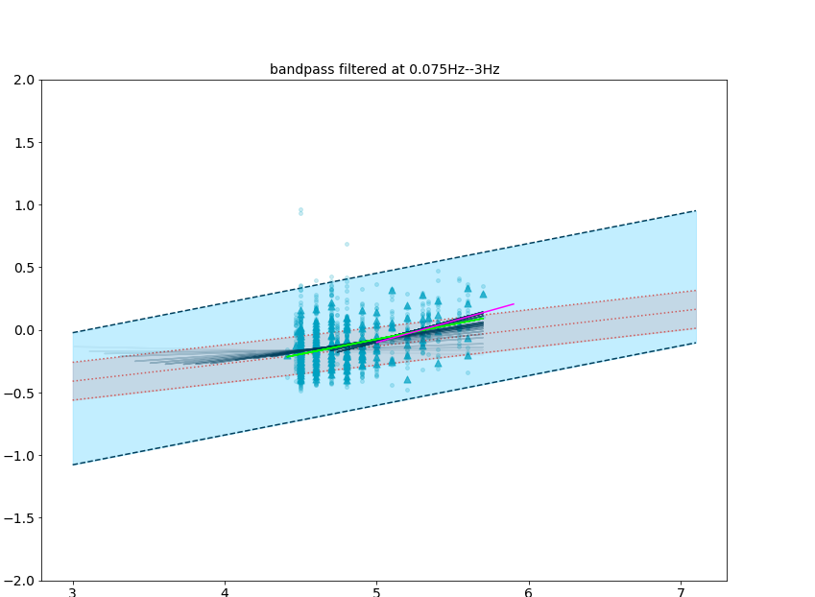
RESULTS
Gain (dB)
0
Ideal response
Frequency (Hz)
0.1 Hz
3 Hz
Log(Maximum predominant period)
Method
Past work
magnitude
Question
Meaning

Slide 26
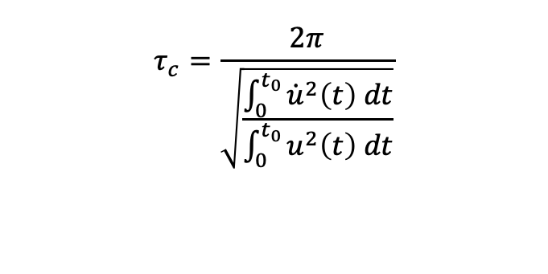
AVERAGE PERIOD
Similar concept but non-recursive method
Time window to consider (=4 s)
$$τ_{c}=\frac{2π}{\sqrt{\frac{\int_{0}^{t_{0}}{{\dot{u}}^{2}\left(t\right) dt}}{\int_{0}^{t_{0}}{u^{2}\left(t\right) dt}}}}$$
average period
High pass filtered displacement
Method

Slide 27
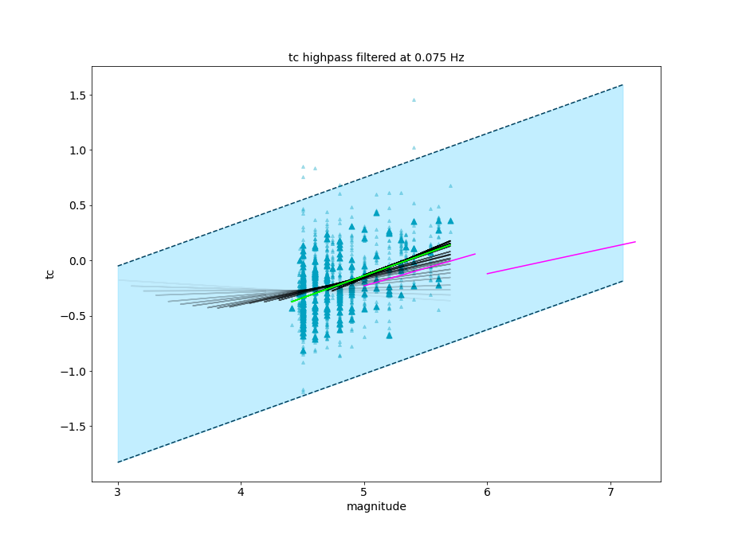
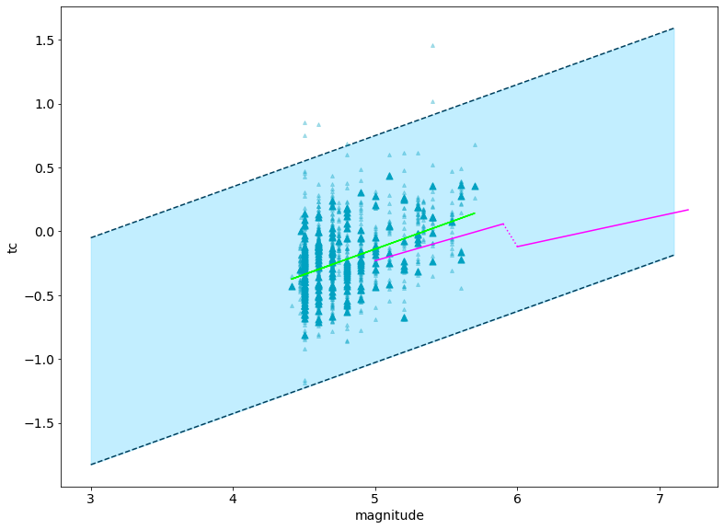
RESULTS
Gain (dB)
0
Ideal response
0.1 Hz
Frequency (Hz)
Log(Average period)
Method
Past work
Magnitude
Question
Meaning

Slide 28
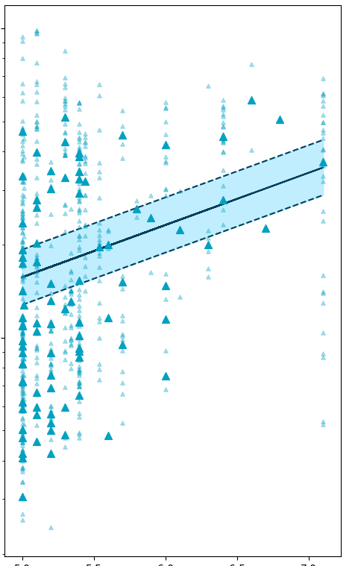
RESULTS
10
Average periXod
1
0.5
5
6X
7
Method
Magnitude

Slide 29
WHAT DOES THIS PHYSICALLY MEAN?
Still get positive fit with earthquake magnitude
Uncertainty is 1-2 orders of magnitude → not useful relation
Look at more physical parameters?
Meaning

Slide 30
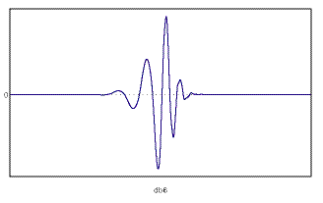
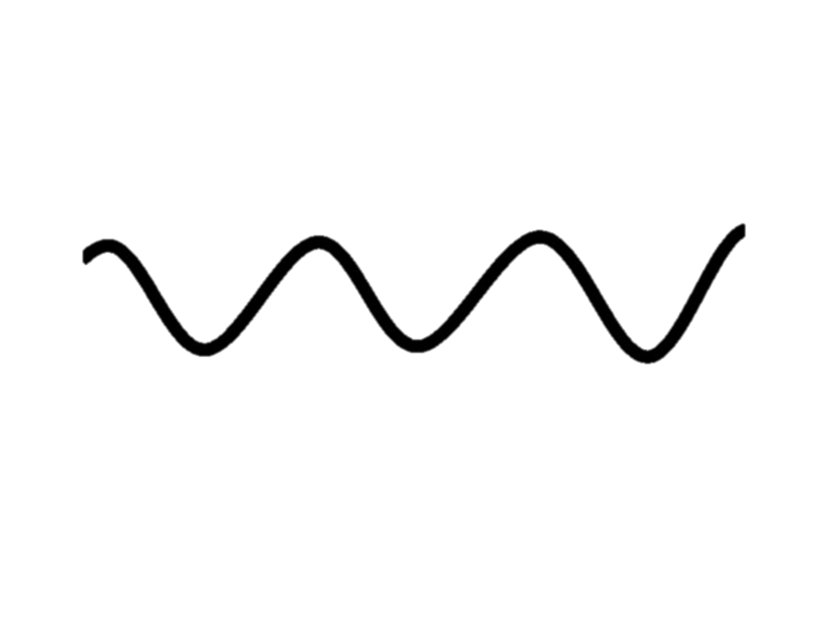
LOOKING AT EARTHQUAKE SPECTRA
FOURIER TRANSFORM
WAVELETS
e.g. Daubechies 6
Advantage of time-frequency localisation
Sines and cosines
Past work
Question
Method
Meaning
Notes:
Wavelets
Rather than using a sinusoidal basis function, use a different basis and then change the length of it in time. Gives us the ability to look at different frequencies at different temporal resolutions

Slide 31
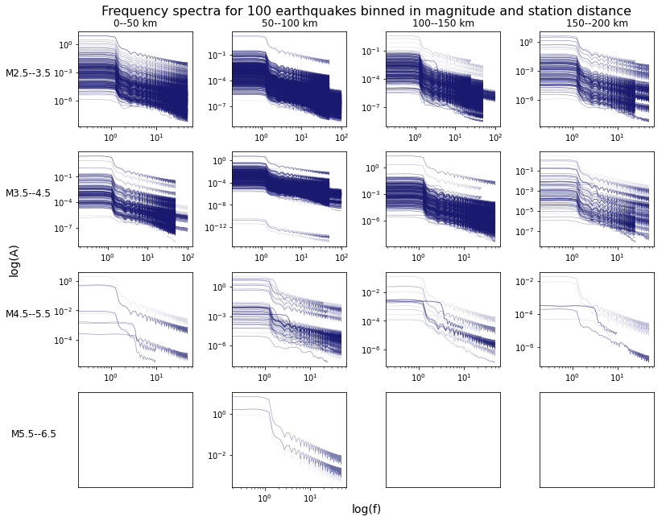
FREQUENCY SPECTRA FOR 100 EARTHQUAKES

Slide 32
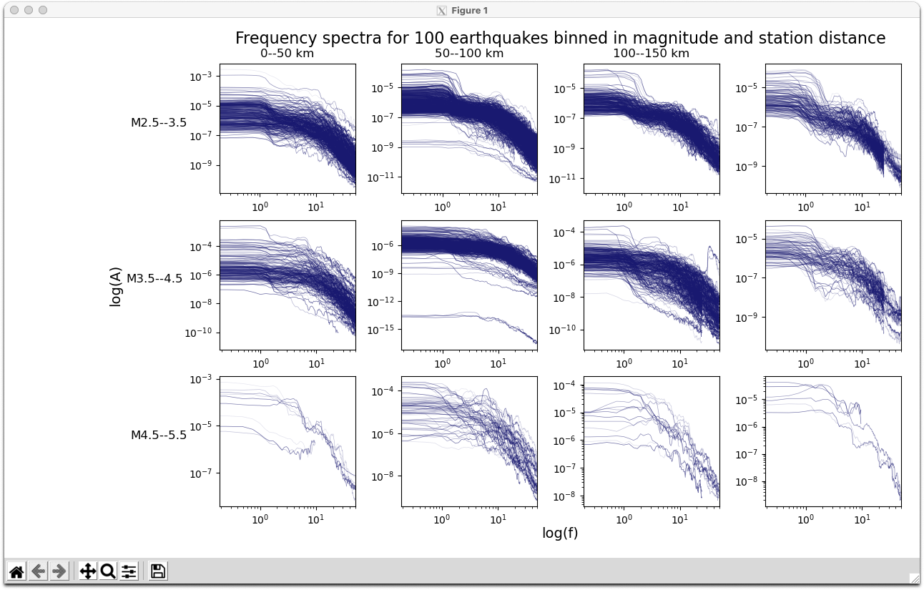
FREQUENCY SPECTRA FOR 100 EARTHQUAKES
0--50 km
50--100 km
100--150 km
150--200 km
M2.5—3.5
M3.5—4.5
M4.5—5.5

Slide 33
FREQUENCY SPECTRA FOR 100 EARTHQUAKES
0--50 km
50--100 km
100--150 km
150--200 km
M2.5—3.5
M3.5—4.5
M4.5—5.5
Meaning
Notes:
mshimamoto@agu.org
Robert Goldman 4:17 pm
https://agu.confex.com/agu/fm21/meetingapp.cgi/Paper/971795
^My talk is Thursday at 3pm Central (1pm Pacific)
M
MATIAS ROMERO 4:19 pm
https://agu2021fallmeeting-agu.ipostersessions.com/default.aspx?s=94-16-74-24-14-D4-54-1E-16-81-57-46-9B-D3-8B-BE&guestview=true
R
Robert Goldman 4:20 pm
Mark's email: mshimamoto@agu.org
A
Austin Carter 4:20 pm
agu2021fallmeeting-agu.ipostersessions.com/Default.aspx?s=A2-61-A4-12-A3-FC-39-C3-2B-5F-AC-3C-39-F2-E4-FA
matias.romero@unc.edu.ar
@paleoclimati

Slide 34
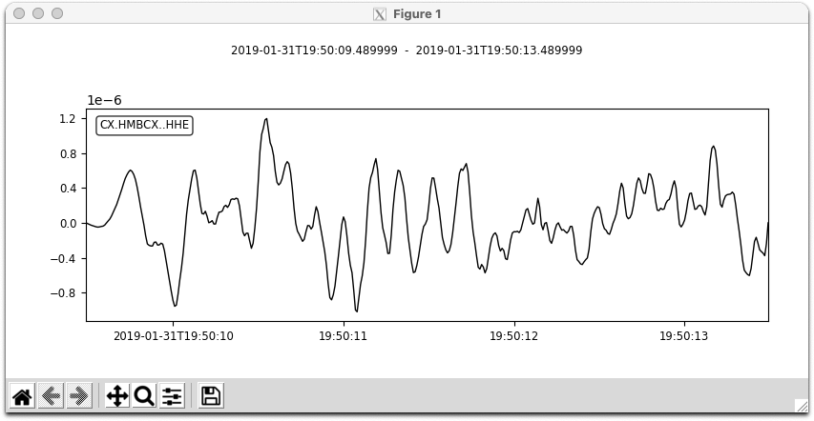
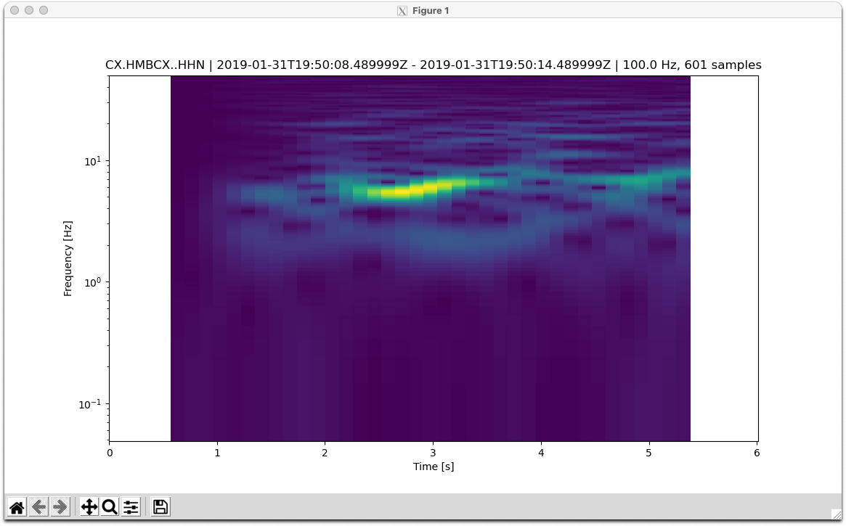
SPECTROGRAM
Gain (dB)
0
Ideal response
0.25 Hz
Frequency (Hz)
10
Frequency (Hz)
1
Average period = 0.689
Predominant period = 0.507
0.1
-1
0
=P
1
2
3
4
5
Time (s)
Meaning
Notes:
mshimamoto@agu.org
Robert Goldman 4:17 pm
https://agu.confex.com/agu/fm21/meetingapp.cgi/Paper/971795
^My talk is Thursday at 3pm Central (1pm Pacific)
M
MATIAS ROMERO 4:19 pm
https://agu2021fallmeeting-agu.ipostersessions.com/default.aspx?s=94-16-74-24-14-D4-54-1E-16-81-57-46-9B-D3-8B-BE&guestview=true
R
Robert Goldman 4:20 pm
Mark's email: mshimamoto@agu.org
A
Austin Carter 4:20 pm
agu2021fallmeeting-agu.ipostersessions.com/Default.aspx?s=A2-61-A4-12-A3-FC-39-C3-2B-5F-AC-3C-39-F2-E4-FA
matias.romero@unc.edu.ar
@paleoclimati

Slide 35
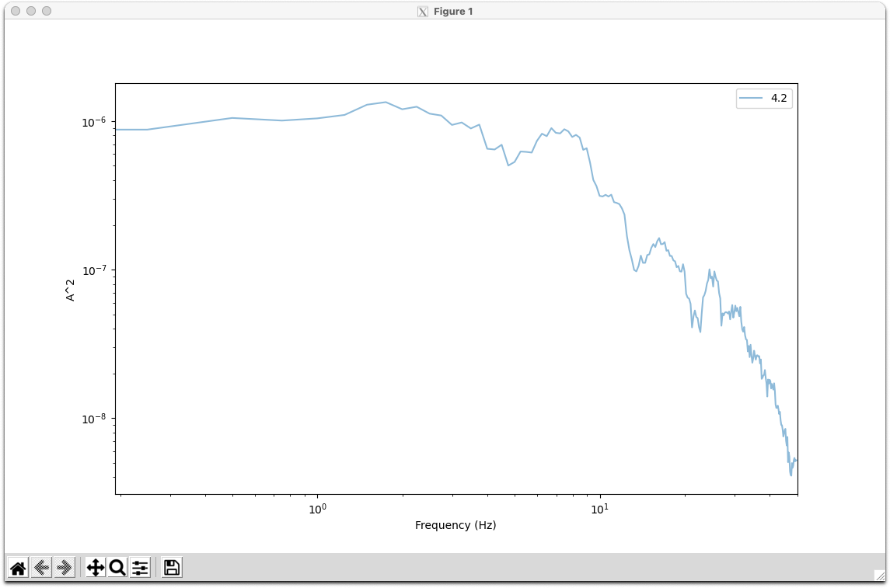
SPECTROGRAM
Gain (dB)
0
Ideal response
M4.2, Chile
0.25 Hz
Frequency (Hz)
10
Frequency (Hz)
1
Average period = 0.689
Predominant period = 0.507
0.1
-1
0
=P
1
2
3
4
5
Time (s)
Meaning
Notes:
Band [0.518241930607, 0.437544267329, 0.401698591703]
High [0.16607816381, 0.108053433963, 0.150722188794]
Low [0.536577233006, 0.443124489655, 0.402395198385]
mshimamoto@agu.org
Robert Goldman 4:17 pm
https://agu.confex.com/agu/fm21/meetingapp.cgi/Paper/971795
^My talk is Thursday at 3pm Central (1pm Pacific)
M
MATIAS ROMERO 4:19 pm
https://agu2021fallmeeting-agu.ipostersessions.com/default.aspx?s=94-16-74-24-14-D4-54-1E-16-81-57-46-9B-D3-8B-BE&guestview=true
R
Robert Goldman 4:20 pm
Mark's email: mshimamoto@agu.org
A
Austin Carter 4:20 pm
agu2021fallmeeting-agu.ipostersessions.com/Default.aspx?s=A2-61-A4-12-A3-FC-39-C3-2B-5F-AC-3C-39-F2-E4-FA
matias.romero@unc.edu.ar
@paleoclimati

Slide 36
FITTING IN WITH OTHER METHODS
2
Maximum predominant period
1
0.5
3
4
5
6
7
Method
Magnitude
Past work
Question
Question
Meaning

Slide 37
IN SUMMARY
AIM
Are earthquakes deterministic?
What does this physically mean?
SO FAR
Looked at seismogram attributes
Positive relationship with magnitude but large scatter
NEXT
Looking at spectra
Compare between magnitude, distance, setting and depth bins
No physical meaning?
Later: look at source time functions
Use representative data set

